Slide 1
Group 11
razvan muresan
joseph shuttlewood
tyler martignetti
john rance

Slide 2
Our solution to the brief
2D GAME
SINGLE TOUCH MECHANIC
TURN BASED MULTIPLAYER
SYMMETRICAL
SIMPLE AND INTUITIVE GAMEPLAY

Slide 3

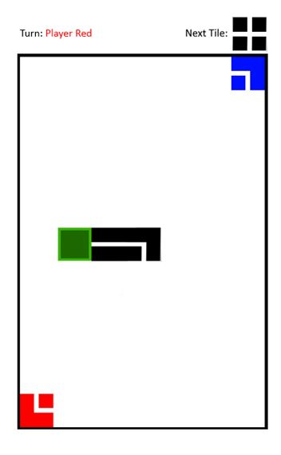
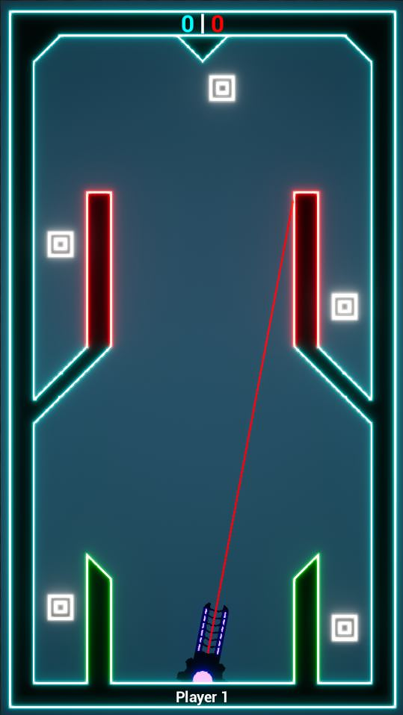
Adjustment based on feedback
Initial prototype (left)
Not symmetrical
Random factor
Second prototype (right)
Both players interact with the game identically
Random factor removed

Slide 4
What does the player do?
one cannon that can only shoot once
Players take turns to shoot the cannon
The projectile interacts in different ways with different blocks
First player to shoot the majority of special blocks wins the game
Special block

Slide 5
Feature list
Cannon
Rotates left to right
Fires bullets
bullets
Bounce off of walls
Destroy targets and certain tiles
Get destroyed after 5 bounces
Targets
Can move between waypoints
Grants points upon being destroyed
First to destroy the majority of targets wins
Tiles
Blue tiles – bounce bullets
Red tiles – destroy bullets
Green tiles – destroyed by bullets

Slide 6
The challenge
prediction
timing
Strategy
Notes:
Prediction – Predicting where to shoot and when to shoot
Timing – Making sure your bullets will make it there in time
Strategy – Not destroying green blocks that help the enemy, planning out your shots to put yourself in a winning position. Forcing the enemy to help you by destroying green blocks.

Slide 7
Design choices
neon theme
speed of the cannon
speed of the bullet
speed of the targets
colour coded intuitive design
limited number of bounces
Notes:
Neon Theme – Why – Easy to do and appeals to a wider audience
Speed of the cannon – Why we chose to go with the speed we did. Might change after playtesting
Speed of the bullet – Fairly irrelevant but helps with visual aids
Speed of the targets – Adds to the difficulty of the game.
Colour coded intuitive design – A lot of work went into making the game intuitive. Red blocks bad, green blocks destroyable. Makes the game easy to pick up even if you haven’t read the how to play screen.
Limited number of bounces – The game doesn’t go on forever.

Slide 8
DEMO

Slide 9
Feedback on the game
Quotes
“turret could be a little bit faster” – alice
“it’s really clear what to do, you don’t even need instructions” – beth
“The aiming is a bit too slow” – tom
“you should add different colour bullets for each player” – quwaine
Observations
2/10 people opened how to play
Audible reactions to close/missed shots
Level 1 is too hard
Notes:
Quotes: Of the 10 people we’ve had playing our game these were the remarks that stood out.
Observations: Of all the people that played the game these are the most common things said.

Slide 10
Goals
Short term goals (1-3 weeks)
Sound implementation
Playtesting powerups
Adding a next level button
Turn timer
More particle effects
Stretch goals
Dynamically updating materials
Analytics implementation
Cannon and bullet customization
Notes:
Short term goals: Things we will end up implementing into the game. Obviously more levels.
Stretch goals – If we implement every goal on the short term goal list we might look into implementing some of these.

Slide 11
Questions
Please playtest our game. Feedback is more than welcome through email or in person.
https://goo.gl/dGVxx7

